Slide 1
PDF Link Extractor

Slide 2
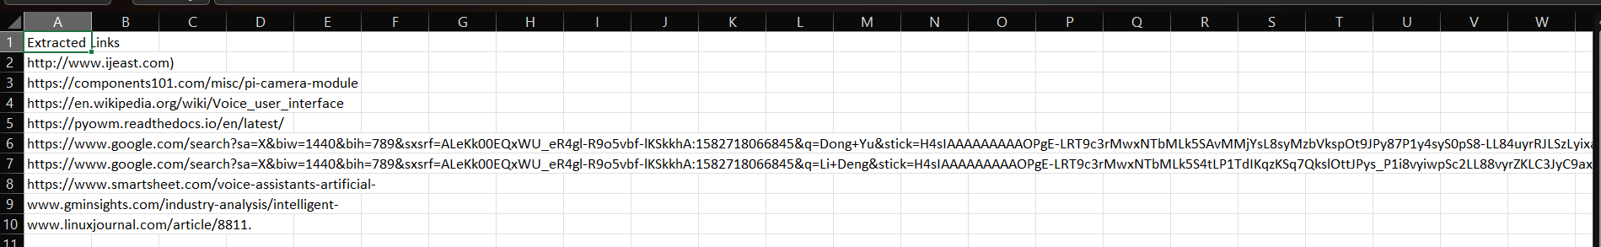
Output from PyMuPdf

Slide 3
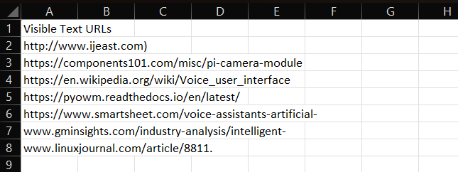
Output from PdfPlumber

Slide 4
Output from PyPdf

Slide 5
Feature | PyMuPdf | pdfplumber | PyPdf
Extract visible URLs | Yes | Yes | No
Extract embedded hyperlinks | Yes | No | Limited
Extract full text content | Yes | Yes | No
Text layout awareness | Basic | Excellent | No
Best use case | Full link extraction | Layout-rich text extraction (Tables, explicitly printed URLs) | Metadata-level URI extraction (Digital Forms)
Feature

